Slide 1
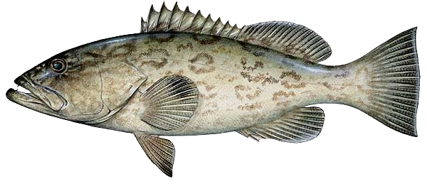
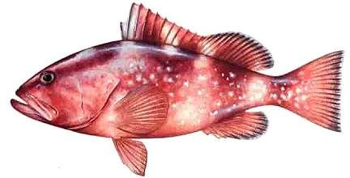
Gulf Of Mexico; Commercial Fishing for Red and Gag Grouper

Slide 2
The Groupers
The most aggressive and largest females shifting sex to male, as a result of behavioral triggers, when there is no male available.
Commercial and sport fishing have created tremendous selective pressures against the largest animals, typically male, restricting the reproductive capacity of the entire breeding population

Slide 3
Grouper
Found in areas of hard or consolidated substrate, and use structural features such as ledges, rocks, and coral reefs as well as artificial reefs like wrecks and sunken barges.
The world record is 80 lbs. 6 oz.
Flaky white meat that is considered quite delicious.

Slide 4
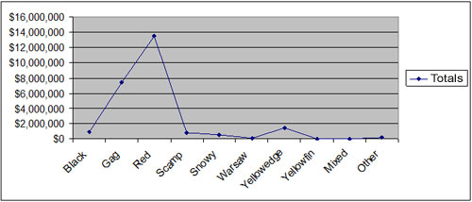
Economic Impact
2005 Dockside Value of Florida Grouper Species
Species | Dollars
Black | $926,644
Gag | $7,418,679
Red | $13,431,704

Slide 5
2005 Grouper Landings by Coast per pound
Species | Atlantic | Gulf Of Mexico
Black | 15,437 | 340,799
Gag | 141,420 | 2,654,672
Red | 19,793 | 6,389,727

Slide 6
2005 Florida Grouper Landings by Month
 | Y-fin | Mixed | Warsaw | Other | Black | Scamp | Snowy | Y-edge | Gag | Red | Totals
Jan | 30 | 103 | 4,829 | 7,400 | 29,600 | 33,120 | 43,640 | 83,501 | 423,758 | 725,650 | 1,351,631
Feb | 34 | 0 | 3,347 | 9,817 | 36,824 | 29,001 | 34,383 | 83,051 | 244,554 | 654,860 | 1,095,871
Mar | 5 | 2 | 3,641 | 20,241 | 20,752 | 27,074 | 46,908 | 136,792 | 169,176 | 362,535 | 787,126
Apr | 0 | 0 | 4,411 | 8,919 | 32,971 | 36,923 | 23,559 | 46,176 | 287,775 | 669,396 | 1,110,130
May | 3,322 | 0 | 5,167 | 28,059 | 57,631 | 45,348 | 36,987 | 137,253 | 318,757 | 801,305 | 1,433,829
June | 98 | 0 | 4,961 | 20,342 | 37,995 | 39,533 | 28,781 | 99,088 | 226,821 | 752,826 | 1,210,445
July | 0 | 0 | 109 | 457 | 37,485 | 29,218 | 9,529 | 350 | 382,290 | 725,233 | 1,184,671
Aug | 0 | 4 | 0 | 363 | 37,273 | 45,414 | 6,879 | 457 | 369,239 | 974,797 | 1,434,426
Sep | 0 | 5 | 12 | 603 | 26,106 | 22,495 | 7,625 | 107 | 246,446 | 442,727 | 746,126
Oct | 8 | 61 | 47 | 304 | 17,975 | 13,359 | 5,082 | 257 | 106,711 | 292,110 | 435,914
Nov | 0 | 0 | 0 | 160 | 8,860 | 1,153 | 2,067 | 128 | 7,874 | 2,380 | 22,622
Dec | 5 | 0 | 0 | 22 | 12,764 | 1,101 | 2,515 | 271 | 12,692 | 5,698 | 35,068

Slide 7
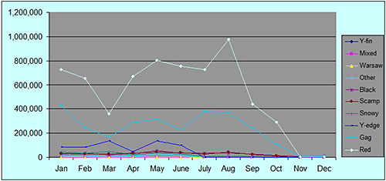

Slide 8
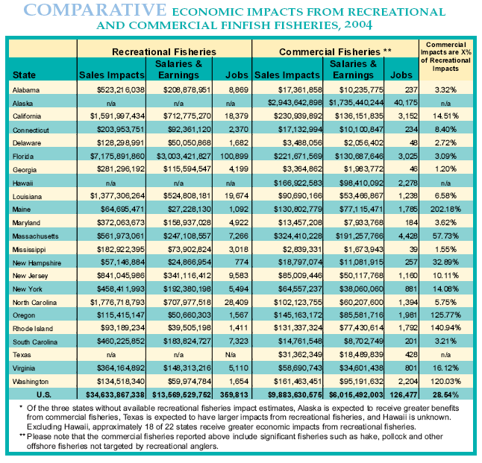
Recreational Vs. Commercial

Slide 9
Overfishing
3 different types
Growth overfishing – is when fish are harvested at an average size that is smaller than the size that would produce the maximum yield per recruit.
Recruit overfishing – is when the mature adult (spawning biomass) population is depleted to a level where it no longer has the reproductive capacity to replenish itself.
Ecosystem overfishing – is when the balance of the ecosystem is altered due to overfishing.

Slide 10
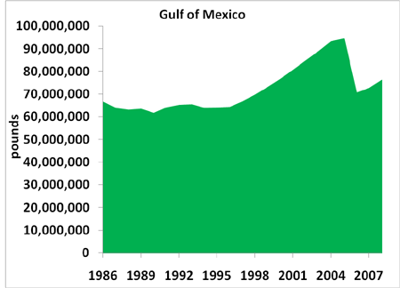
Current Biomass of Red Grouper

Slide 11
How Biomass is Counted
Biomass refers to the amount of red grouper in the ocean. Scientists cannot collect and weigh every single fish to determine biomass, so they use models to estimate it instead. These biomass estimates can help determine if a stock is being fished too heavily or if it may be able to tolerate more fishing pressure.

Slide 12
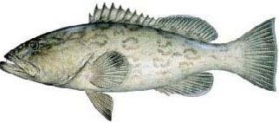
Commercial Fishing
Bandit Fishing
Poles extending from the rails, with electric motors to reel in the line.
Fishermen call this arrangement a "bandit" rig because it resembles a slot machine or "one-armed bandit."
Referred to as selective fishing
More sustainable

Slide 13
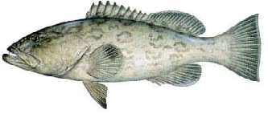

Slide 14
Long Line
long lines are placed horizontally along the bottom with hundreds of leaders and hooks attached. No need to feel for a bite. Just lay out bait a few hours and retrieve the line.
Consumers benefited because long-lining lowered prices. But as with other breakthroughs, abundance brought unexpected side effects.

Slide 15
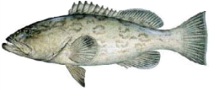

Slide 16
Fish Traps
In 1997 Fish traps were being phased out of the fishing fleet.
The traps were used with great success but if a trap broke free or was lost, the trap would still collect fish.
Reef destruction if the traps landed on the coral.

Slide 17
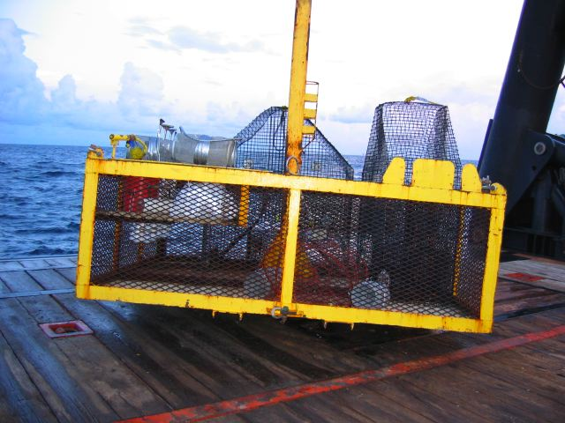
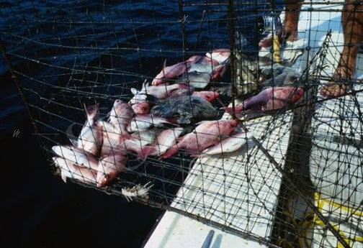
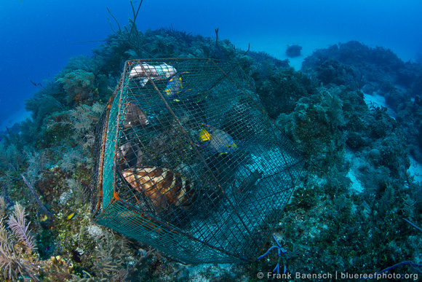
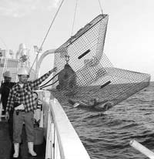

Slide 18
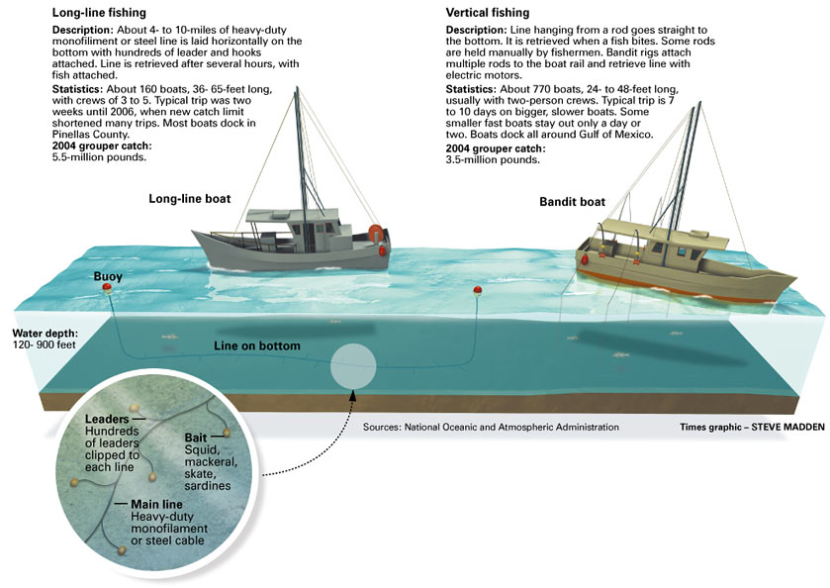

Slide 19
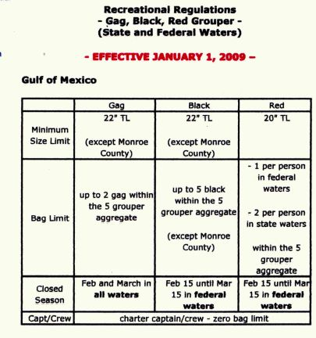
Current Regulations
Annual catch quota for gag grouper was reduced from 1.49 million pounds to 100,000 pounds.
A federal stock assessment for gag grouper in 2009 indicated a need to reduce gag grouper harvest by 70 percent

Slide 20
In 2011, the allowable commercial catch of red and gag grouper was set to be cut from 5.7 million pounds to 4.3 million pounds to keep the rebuilding plan on track.
In 2006, the gag and red grouper catches declined by almost 50 percent, said NOAA Fisheries Southeast Regional Administrator Roy Crabtree.

Slide 21
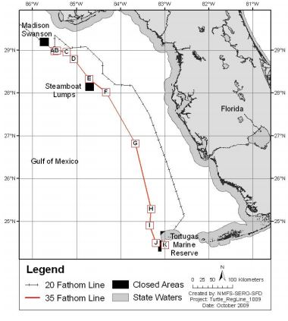
Potential Issues with Long Lining
Sea Turtles
Gulf reef fish bottom longline gear takes loggerhead sea turtles as bycatch. These turtles are listed as threatened under the ESA. Amendment 31 establishes a management strategy to reduce sea turtle bycatch in the bottom longline component of the Gulf of Mexico reef fish fishery.
Reef Destruction
Miles of heavy-duty lines laying on the bottom sometimes snagged coral and rock during retrieval, tearing up valuable habitat.

Slide 22
Massive Bycatch
By the time the lines are drawn in, most of the fish hooked are drowned. The long liners cannot target specific species and drag in sharks, goliath grouper (which are still on the endangered species list), and short fish that aren’t big enough to keep. These fish cannot be kept legally so are either thrown back (usually dead) or used as bait.

Slide 23
Shut down the Commercial Grouper Fishery?
The study found, among other things, recreational gag grouper fishing generates $107 million in value added [to the economy], $60.8 million in income, and supports 1,513 jobs; recreational red grouper fishing generates $35.2 million in value added, $20 million in income and supports 501 jobs.

Slide 24
Why is it Important?
Overfishing can have a cascading effect in marine communities, causing a loss of biodiversity and extreme community fluctuation. Given that red and gag grouper are a major predator, they may be having a huge influence on the species that live there by protecting some from smaller predators that are food for groupers.

Slide 25
How do we prevent overfishing?
Reduction of Annual Fish Quota for Commercial Fishing
Improve data collection methods
Reduction of bycatch
Promote sustainable harvesting techniques.

Slide 26
Improving Data Collection and Fisheries Monitoring
Recreational Sector Separation
Vessel Monitoring System
Telephone or Web-Based Reporting System for both for-hire and private recreational vessels
Electronic Logbooks
Grouper Endorsements
Notes:
Recreational Sector Separation - Divide the recreational allocation into separate for-hire and private recreational allocations. Each sector would have its own annual catch limit and possibly an annual catch target.
Vessel Monitoring System - Require for-hire vessels to allow NOAA Fisheries to monitor a vessel for better enforcement.
Telephone or Web-Based Reporting System for both for-hire and private recreational vessels. Catch can be reported either by telephone or over the Internet to provide more timely and accurate reporting of recreational catch.
Electronic Logbooks - to improve accuracy of data collected, and for use as an in-season monitoring program.
Grouper Endorsements (i.e. stamp) for the for-hire sector to identify the number of grouper fishermen for data collection purposes.

Slide 27
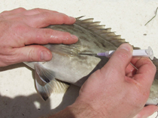
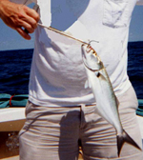
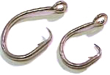
New Regulations Effective June 1, 2008
-Require the use of venting tools
-de-hooking devices
-non-stainless steel circle hooks when using natural baits.

Slide 28
The intent of these new regulations is to reduce bycatch and discard mortality of reef fish that are caught and not kept. If the gear associated with these new regulations is used properly, it will help more reef fish survive when they are released.

Slide 29
The Consequences
A short film that gives a brief look at the big picture.
Video is quite disturbing

